Slide 1
DESIGN ENGINEERING PROJECT
2-DOF Planar Robotic Arm
Trajectory-Controlled Motion using Dual Stepper Motors, Inverse Kinematics & Encoder Feedback
Two-Link Arm • Two Revolute Joints (A, B) • Closed-Loop Path Tracking

Slide 2
Agenda
01
06
Objective & Problem Statement
Trajectory Planning
A systematic look at the design, kinematics, control architecture and implementation of the arm.
02
07
Mechanical Concept — Links & Joints
Inverse Kinematics
03
08
Controllable Parameters
System Architecture & Control
04
09
Forward Kinematics
Implementation Plan & Applications
05
Workspace Analysis

Slide 3
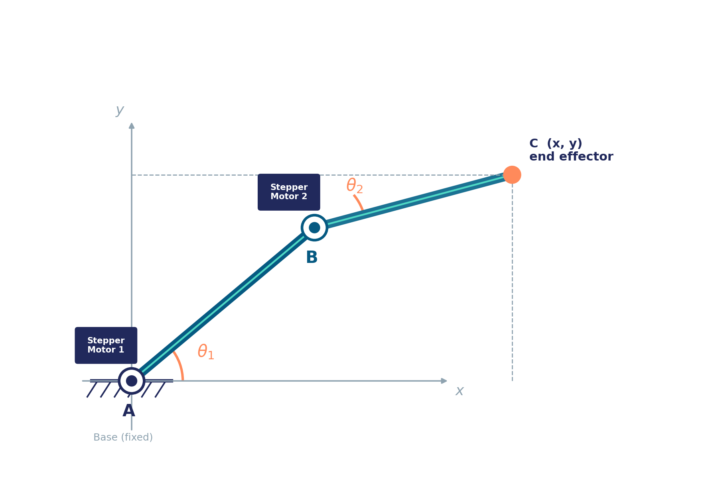
OBJECTIVE
Problem Statement
Design and implement a 2-link, 2-degree-of-freedom planar robotic arm whose end-effector can be commanded to follow a pre-defined trajectory of (x, y) coordinates with accuracy and repeatability.
1
Determine the full set of reachable (x, y) coordinates — the workspace — for a given pair of link lengths.
2
Actuate each joint independently using a dedicated stepper motor for precise angular control.
3
Use rotary encoders on each joint to close the control loop and correct for step loss / drift.
Convert a desired Cartesian path into joint angles (inverse kinematics) and drive the arm smoothly along it.
Two revolute joints, A (base) and B (elbow), each with its own stepper motor and encoder.
4
2-DOF Planar Robotic Arm | Trajectory Control System
3

Slide 4
MECHANICAL DESIGN
Two-Link, Two-Joint Arm
Link AB
Rotates about fixed joint A (motor 1 is the centre of rotation).
Link BC
Rotates about moving joint B (motor 2 is the centre of rotation).
Joint A
Fixed base joint — sets the overall orientation of the arm, angle θ1.
Joint B
Elbow joint — sets the relative bend of the second link, angle θ2.
Point C
End-effector; its Cartesian position (x, y) is what we ultimately control.
2-DOF Planar Robotic Arm | Trajectory Control System
4

Slide 5
MOTION CONTROL
Motion Allowed & Controllable Parameters
Motion allowed
Combined Movement
AB
Circular — with A as the fixed centre of rotation.
A coordinated combination of these four parameters — direction & angle at A, direction & angle at B — can shift the end-effector from one point to another:
BC
Circular — with B as the (moving) centre of rotation.
C → C′
By repeating this for a sequence of target points, the same four controls trace out a continuous trajectory — this is the basis of path following used later in this project.
We can independently control
A →
Direction of rotation
Angle of rotation (θ1)
Every waypoint on a path is just another (θ1, θ2) combination reached through this same control mechanism.
B →
Direction of rotation
Angle of rotation (θ2)
2-DOF Planar Robotic Arm | Trajectory Control System
5

Slide 6
KINEMATICS
Forward Kinematics
Given the two joint angles θ1 and θ2 (and known link lengths L1, L2), the end-effector position (x, y) is fully determined:
x = L1 · cos(θ1) + L2 · cos(θ1 + θ2)
y = L1 · sin(θ1) + L2 · sin(θ1 + θ2)
L1, L2 — fixed lengths of links AB and BC.
θ1 — angle of link AB relative to the base x-axis, set by Motor 1.
θ2 — angle of link BC relative to link AB, set by Motor 2.
These equations let us predict exactly where C lands for any commanded pair (θ1, θ2).
2-DOF Planar Robotic Arm | Trajectory Control System
6

Slide 7
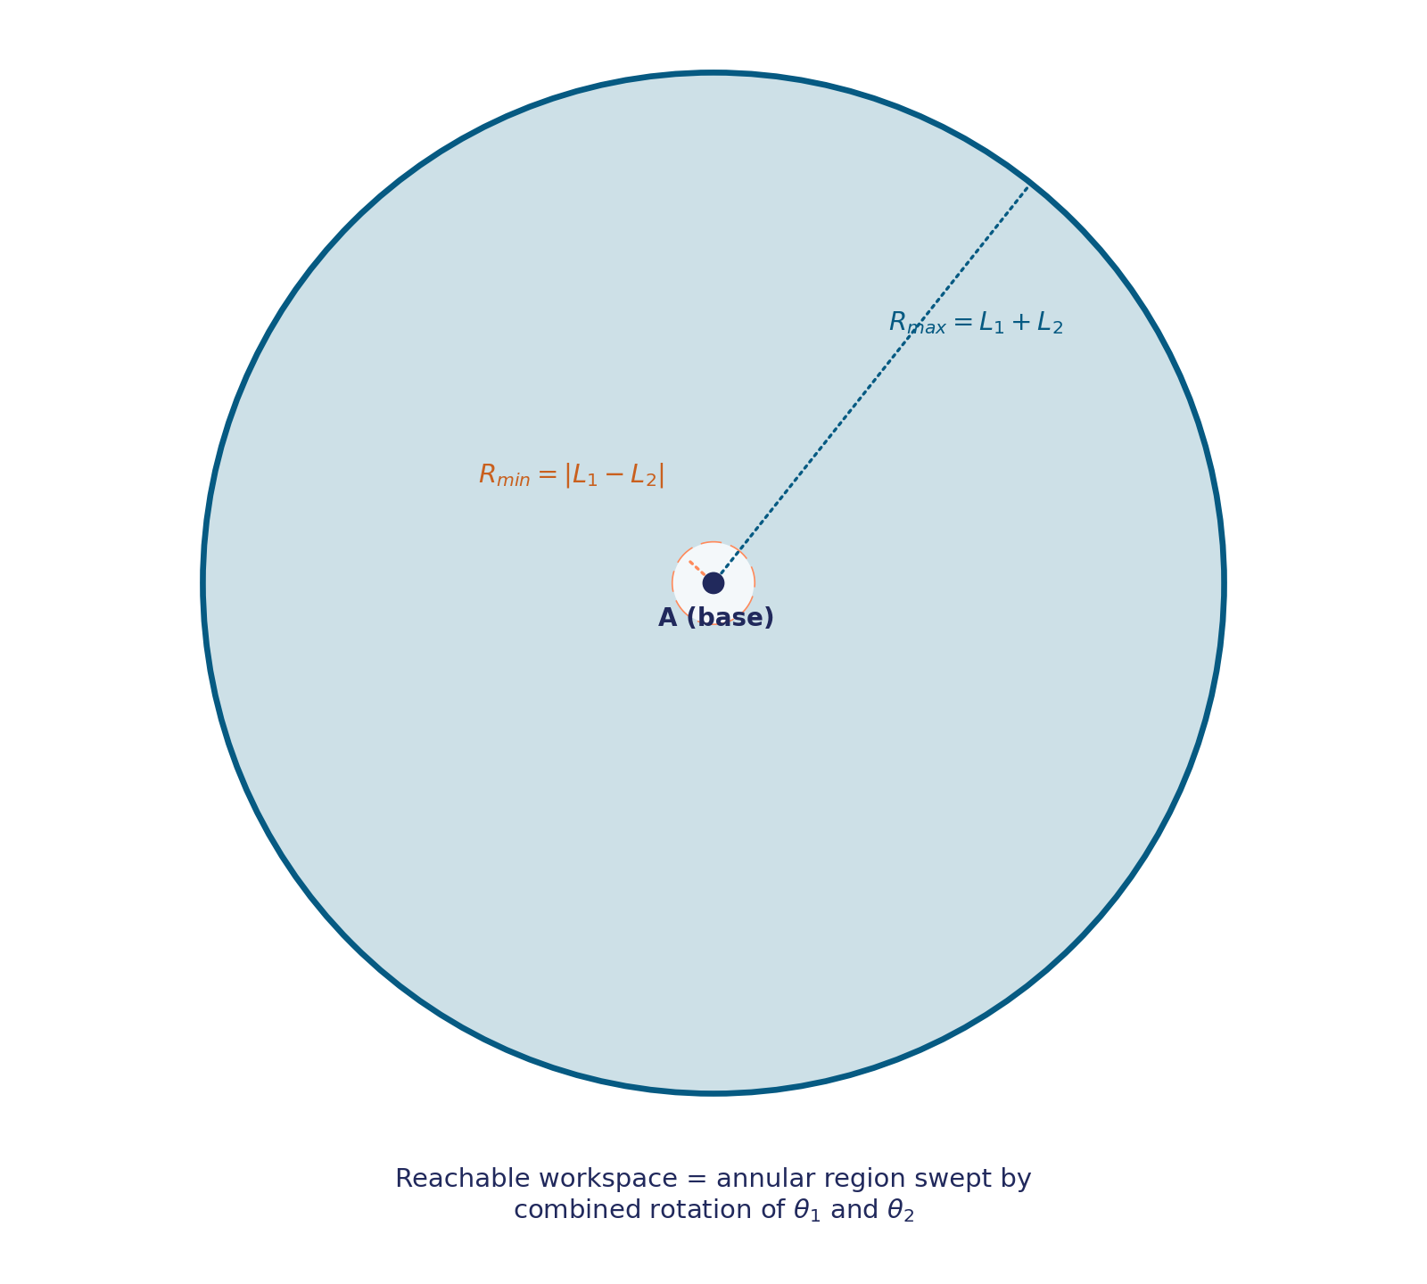
REACHABILITY
Workspace Analysis
The set of all coordinates the end-effector can reach — the workspace — depends only on the two link lengths.
Outer boundary
R max = L1 + L2
Reached when both links are fully extended in a straight line.
Inner boundary
R min = | L1 − L2 |
Reached when the second link folds back over the first.
Reachable region
Annulus between R min and R max
Every valid target coordinate for the planned trajectory must fall inside this region.
2-DOF Planar Robotic Arm | Trajectory Control System
7

Slide 8
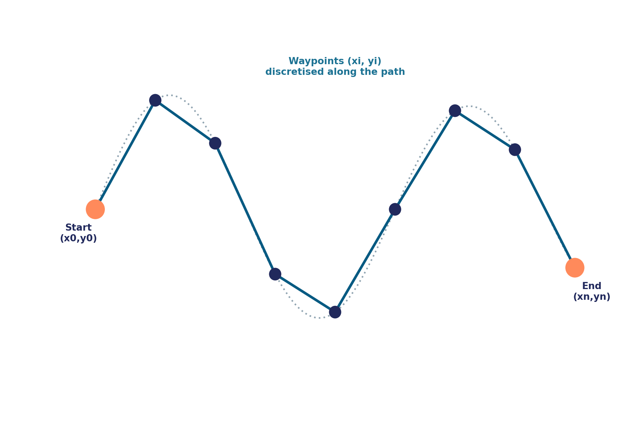
PATH PLANNING
Trajectory Planning
A trajectory is simply an ordered path of coordinates the end-effector must move through, in sequence:
Path = { (x1,y1), (x2,y2), ... , (xn,yn) }
The continuous path is discretised into closely spaced waypoints.
Each waypoint must lie inside the reachable workspace (previous slide).
The controller solves inverse kinematics for every waypoint in turn.
Motors step from one waypoint's (θ1, θ2) to the next, tracing the path.
Finer waypoint spacing → smoother, more accurate traced trajectory.
2-DOF Planar Robotic Arm | Trajectory Control System
8

Slide 9
KINEMATICS
Inverse Kinematics
To follow a trajectory we need the reverse problem: given a target (x, y), find the joint angles (θ1, θ2) that place C there.
Elbow angle
cos(θ2) = (x² + y² − L1² − L2²) / (2·L1·L2)
Solve for θ2; two solutions exist — elbow-up and elbow-down.
1
Shoulder angle
θ1 = atan2(y, x) − atan2(L2·sinθ2, L1 + L2·cosθ2)
θ1 follows once θ2 is fixed, pointing the first link toward the target.
2
Reachability check
R min ≤ √(x² + y²) ≤ R max
Reject / clamp any target that falls outside the workspace annulus.
3
2-DOF Planar Robotic Arm | Trajectory Control System
9

Slide 10
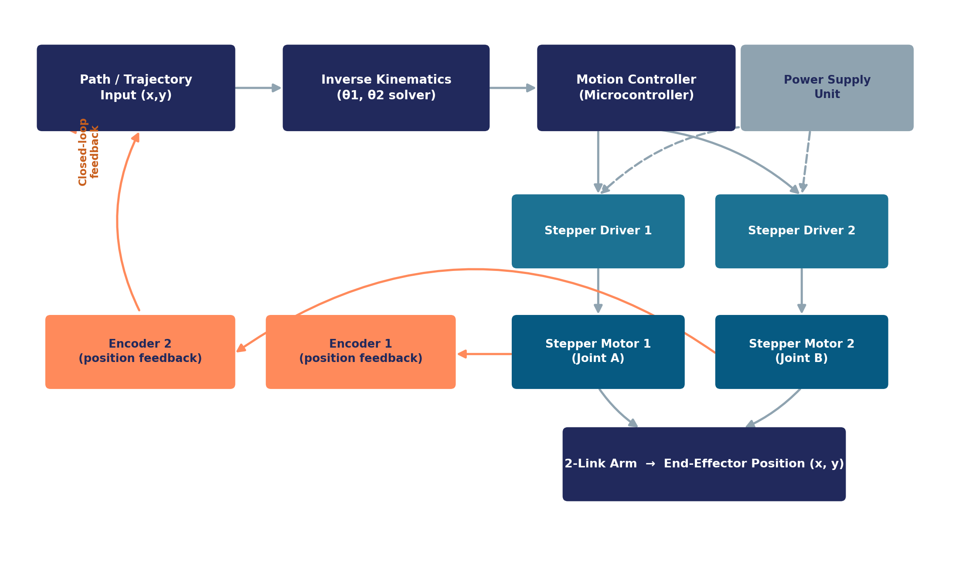
CONTROL ARCHITECTURE
System Architecture
2-DOF Planar Robotic Arm | Trajectory Control System
10

Slide 11
FEEDBACK CONTROL
Why Encoders? — Closed-Loop Control
Stepper motors are normally driven open-loop — the controller assumes every commanded pulse produced exactly one step of movement. Under load, vibration or excess speed, steps can be missed, and position error quietly accumulates along the trajectory.
Open-Loop (motor only)
Closed-Loop (with encoders)
Commanded steps assumed = actual steps
Encoder reports the true joint angle
No knowledge of true joint angle
Controller compares actual vs. desired θ
Errors accumulate silently over a path
Error is corrected before the next waypoint
Cheaper, simpler, but drift-prone
Accurate, repeatable trajectory tracking
2-DOF Planar Robotic Arm | Trajectory Control System
11

Slide 12
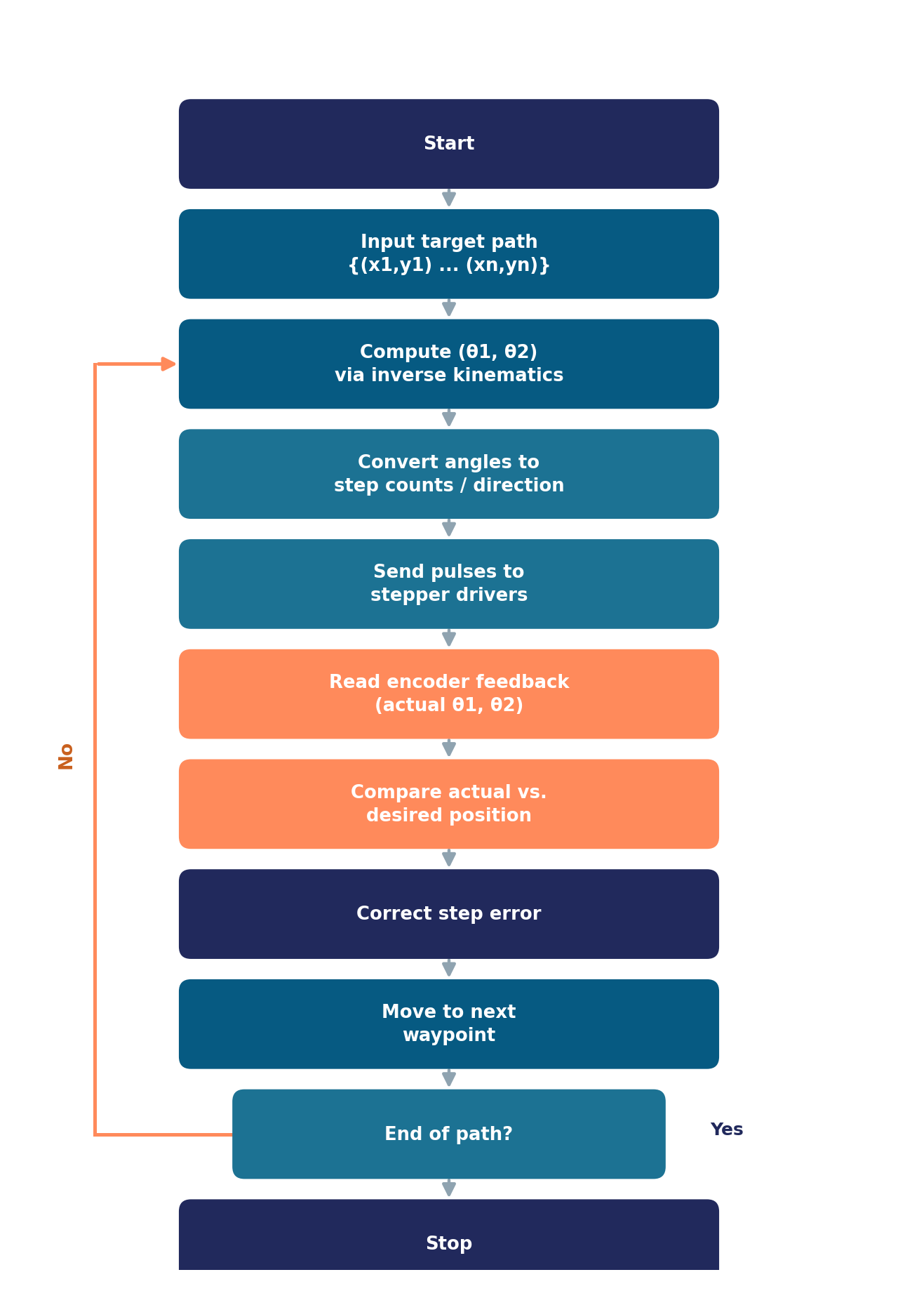
FIRMWARE LOGIC
Control Algorithm
1
The target trajectory is loaded as an ordered list of (x, y) points.
2
Inverse kinematics converts each point into a joint-angle pair.
3
Angles are translated into step counts and rotation direction for each driver.
4
After each move, encoders confirm the joints reached the commanded angles.
5
Any discrepancy is corrected before advancing to the next waypoint — keeping the traced path close to the planned one.
2-DOF Planar Robotic Arm | Trajectory Control System
12

Slide 13
HARDWARE
Bill of Materials
Component | Qty | Role in the System
Microcontroller (Arduino / ESP32) | 1 | Runs trajectory logic, inverse kinematics & motor commands
Stepper Motors (NEMA-17 or similar) | 2 | Actuate joint A and joint B
Stepper Drivers (A4988 / DRV8825) | 2 | Convert step/direction signals into motor phase currents
Rotary Encoders | 2 | Measure actual joint angles for closed-loop feedback
Link members (AB, BC) | 2 | Rigid arm segments — aluminium / 3D-printed
Base frame & bearings | 1 set | Mounts joint A, supports structural loads
Power Supply Unit | 1 | Delivers regulated power to motors & controller
2-DOF Planar Robotic Arm | Trajectory Control System
13

Slide 14
ROADMAP
Implementation Plan
1
2
3
Mechanical Design
Kinematic Modelling
Electronics & Wiring
Model links, joints & base; select link lengths for the target workspace.
Derive & simulate forward / inverse kinematics; validate reachable area.
Wire stepper drivers, motors, encoders and power supply to the controller.
4
5
6
Firmware Development
Feedback Integration
Trajectory Testing
Implement IK solver, step/direction generation and waypoint sequencing.
Read encoders, close the control loop, calibrate zero positions.
Run test paths, measure tracking error, tune and finalise the system.
2-DOF Planar Robotic Arm | Trajectory Control System
14

Slide 15
USE CASES
Applications
Pick & Place Automation
2D Plotting / Drawing
Educational Robotics
Moving small parts between fixed points on an assembly line.
Tracing shapes, text or CNC-style patterns on a flat surface.
Teaching kinematics, control loops and embedded motor control.
Prototype for Prosthetics
Lab & Assembly Fixtures
Research on Path Tracking
Testbed for lightweight, precisely-controlled limb segments.
Repeatable low-cost positioning for inspection or dispensing.
Platform for testing trajectory & control algorithms cheaply.
2-DOF Planar Robotic Arm | Trajectory Control System
15

Slide 16
WRAP UP
Conclusion & Future Scope
Conclusion
A 2-link, 2-DOF arm gives a well-defined, calculable workspace from just two link lengths.
Future Scope
Add a 3rd joint / gripper for full pick-and-place capability.
Independent stepper control at A and B, guided by forward/inverse kinematics, is sufficient to place the end-effector anywhere inside that workspace.
Introduce PID tuning on the feedback loop for faster, smoother correction.
Encoders close the loop, turning an open-loop stepper system into an accurate trajectory-tracking one.
Add vision-based feedback for closed-loop position verification.
Enable wireless (Bluetooth / Wi-Fi) trajectory upload and control.
Optimise link lengths and motor sizing for higher payload capacity.
2-DOF Planar Robotic Arm | Trajectory Control System
16

Slide 17
Thank You
Questions & Discussion
2-DOF Planar Robotic Arm — Trajectory-Controlled Motion using Dual Stepper Motors & Encoder Feedback

